Slide 1
Robotics and Autonomous Systems
ELEG 491

Slide 2
Main themes that touch on ethics:
Risk (engineering) problem w/values
Autonomy (philosophy)
Interaction, Trust and Acceptance (psychology)

Slide 3
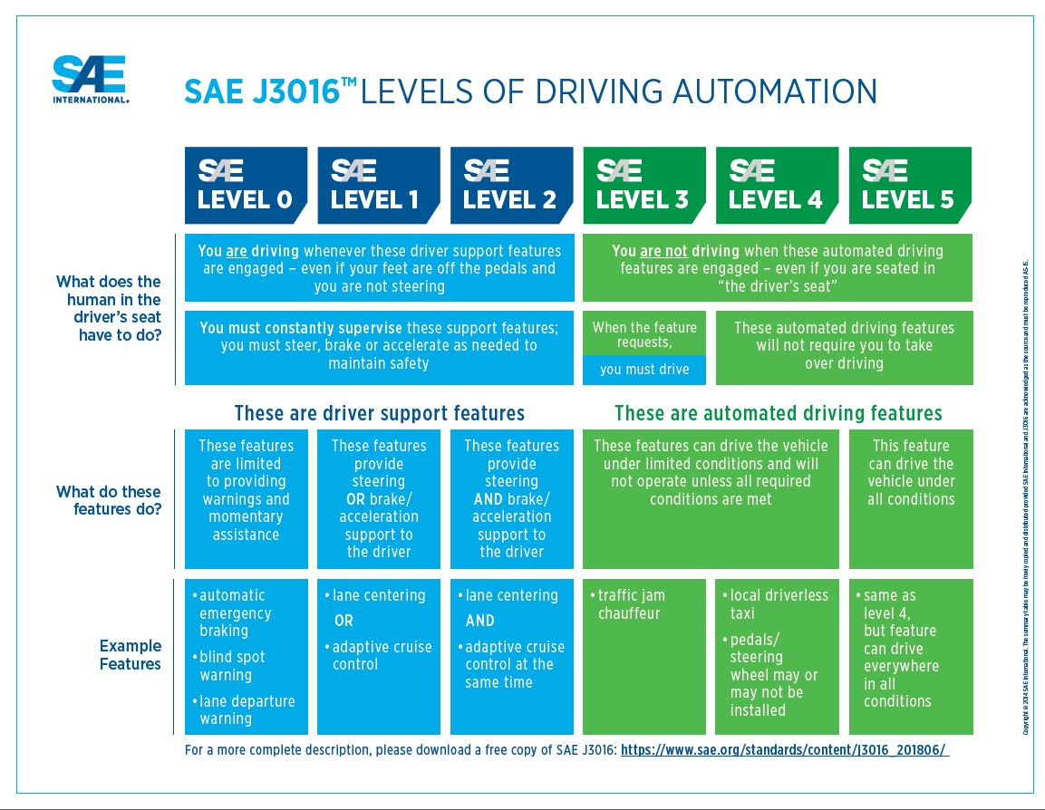
Let’s start with an “easy” example for ethics: autonomous vehicles

Slide 4
Minimizing risk and selecting “the right action” vs. “the good outcome”
Trolley Dilemma:
A runaway trolley is on a track, headed in such a way that it will kill ﬁve people on the track. It can be turned by a switch, available to an agent, which if pulled will cause the trolley to head towards and kill one person on another track. Pulling the switch is the only way to save the five people. Is it morally permissible for the agent to pull the switch and thus save ﬁve people while killing one?
Footbridge Dilemma:
Similarly, a runaway trolley is headed towards ﬁve people, but now the agent is standing next to a large person on a footbridge over the track. The only way to save the ﬁve people is to push the large person onto the tracks below, thus killing him. Is it morally permissible to push the person onto the track, thus saving five people while killing one?
See Foot, P. (1978) The problem of abortion and the doctrine of the double effect, in Virtues and Vices (Oxford: Basil Blackwell) and Thomson, J.J. (1976) Killing, letting die, and the trolley problem, The Monist 59.

Slide 5
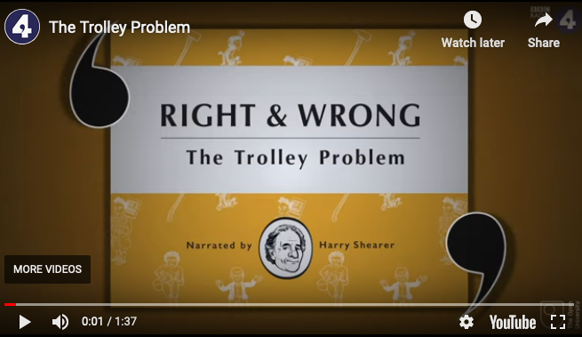

Some other fun sources for the “trolley problem”
The Trolley Problem Now, by Sara Bizarro
Harry Shearer’s depiction for the BBC
This episode of “The Good Place”

Slide 6
Now consider that an autonomous vehicle is “the agent”
Crash Dilemma:
A driverless car with n passengers is proceeding down a road when an obstacle is introduced into its path. If the car hits the obstacle, it will kill the passengers. It can swerve left or right (take evasive maneuvers), which will kill other (m: m >n) bystanders. Since one design goal of any car is to protect its inhabitants, it seems that the driverless car should swerve and kill the bystanders. But more people will be killed by the car following its design goal here if it takes evasive maneuvers. How should the car be programmed?

Slide 7
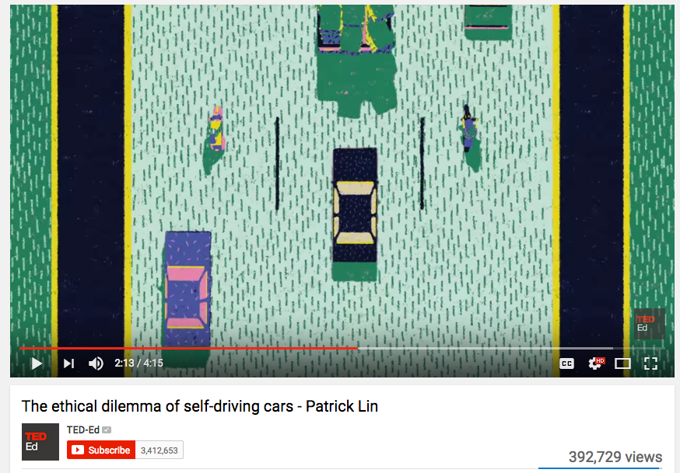
What happens when humans are no longer expected to ”do something”?
The “Trolley Problem” Crash Scenario

Slide 8
What design will car manufacturers choose?

Slide 9
There are many “crash” dilemmas
Crash1: dead Passengers > dead Bystanders
Crash2: dead Passengers < dead Bystanders
Crash3: prob₁ (dead Passengers)> prob₂ (dead Bystanders)
Crash4: p₁ (Damage₂) > p₂ (Damage₂) [where D=injury and cost]

Slide 10
There are also morally-relevant scenarios beyond “crash”
3-car Tailgating with “mixed” Avs & non-AVs
Crosswalk “intervention”
Brake Failure
Chicken between AV & non-AV

Slide 11
There are competing research programs to design ethics into AVs
Optimization with lives (QALY)/$
Bottom-up Approaches: Machine Learning
Top-down Approaches: Non-monotonic (defeasible) control, Deontic logics
Proprietary models
Centralized (networked) and Decentralized systems

Slide 12
Lin’s argument about “moral gray spaces” in AI
Many AI design decisions will not be “obviously” right or wrong
E.g.: highway lane spacing
traffic routing apps (Waze)
These issues will infect other AI systems, e.g., care robots and delivery drones

Slide 13
What do we mean by “autonomy”?
Philosophy (Kant): the ability to make morally-relevant choices independent of influencing factors (both nature and nurture). This is how reason becomes “practical.”
Engineering (SAE): the machine acts independently of user control in all scenarios (level 5), well beyond “driver support”
To what extent is SAE level 5 autonomy independent of all human (direct) control?

Slide 14
Can machines ever be autonomous (moral) agents?
First of all, can computers think? This has been a matter of debate, from Turing to Searle and beyond.
Consider the famous “Chinese Room” thought experiment proposed by Searle.
(Or, if you are really interested, dive down this rabbit hole, from the Consortium for Cognitive Science Instruction)

Slide 15
Searle’s argument relies on:
The claim that simulation of mental operations is not “realization” of a mind
The claim that thinking requires (self-originating) semantic ability
The claim that all the computer has is syntax, and syntax isn’t sufficient for semantics

Slide 16
What are the conditions for moral agency?
Decision-making ability
Effective decisions (causal actions)
And perhaps also that the agent intends its actions
(Philosophers are divided on whether a machine can meet any of these conditions and whether it could pass the “Moral Turing Test”)

Slide 17
Trusting Robots and other Autonomous Systems
A social robot is an autonomous or semi-autonomous robot that interacts and communicates with humans by following the behavioral norms expected by the people with whom the robot is intended to interact.
[Bartneck, Forlizzi (2004)]

Slide 18
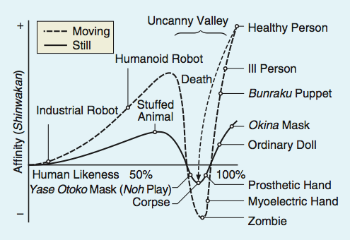
The Psychology of Trust: Mori’s Uncanny Valley

Slide 19
Sociable Robot properties: (according to Marc Hanheide)
embodiment in a situated manner
lifelike qualities (anthropomorphization, tendency to interpret behavior as being intentional)
identifying persons, their actions and intentions: Theory of Mind and empathy core for human awareness
Learning of social situations, shaping robot’s personal history by imitation or mimicry.
being understood: ability to read the activities (expressions, mimic, etc.) of a robot.

Slide 20
Here are some…
Optimistic portrayals
and some
Worrisome ones
(See “Escaping from Children’s Abuse of Social Robots,” by Dražen Brščić, Hiroyuki Kidokoro, Yoshitaka Suehiro, and Takayuki Kanda, HRI 2015 )

